Slide 1
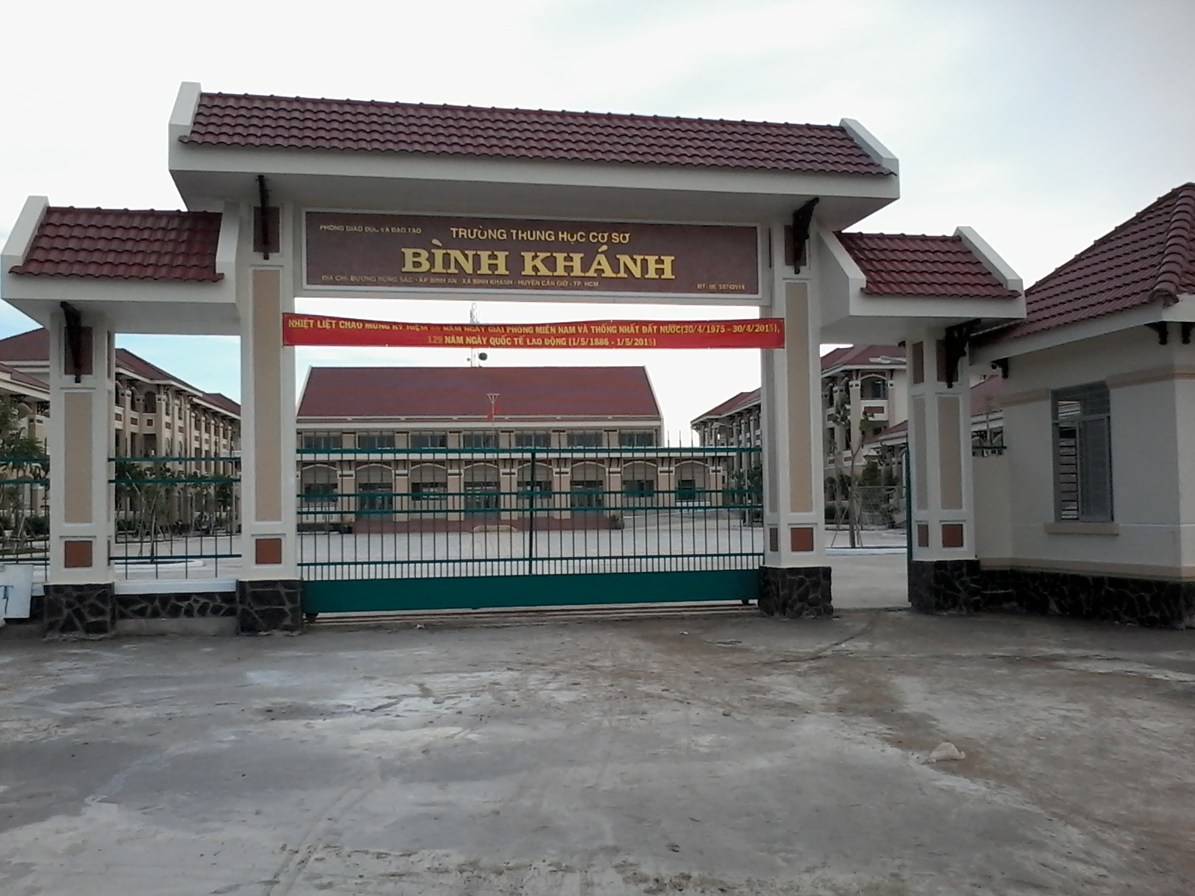
BINH KHANH SECONDARY SCHOOL
FRIENDS PLUS 6

Slide 2
GAME
ROLL A RANDOM ASSOCIATION

Slide 3
1
Sandwich
desserts
2
menu
3
4
5
serve
vegetarians
lunch
healthy
dish
6
7
8

Slide 4
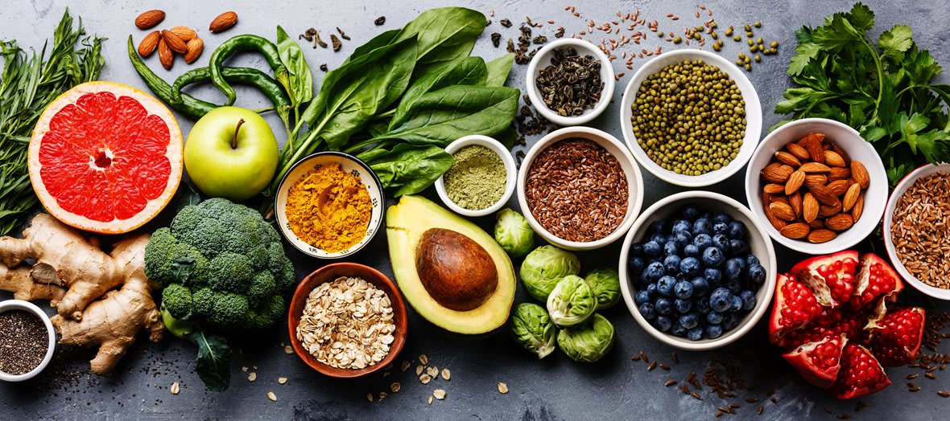
UNIT 5:
FOOD AND HEALTH
Lesson 3
LANGUAGE FOCUS

Slide 5
Activity 1:
apple, egg, sweet, snack
Countable Noun:
Uncountable Noun:
juice, bread, pasta, water
Rules:
1. an egg / eggs, a sweet / sweets, a snack / snacks
2. bread, pasta, water

Slide 6
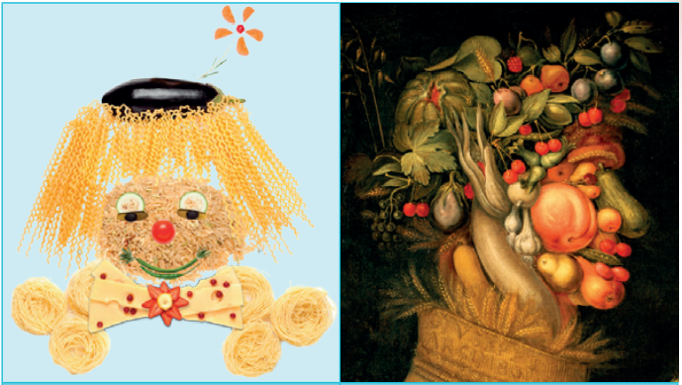
Activity 2:
rice
cheese
3. meat
4. vegetables
5. pears
6. crisps

Slide 7
Activity 3:

Slide 8
1. MANY / MUCH
MANY + Plural countable nouns
MUCH + Uncountable nouns
Example: 1) How many eggs?
2) How much bread?

Slide 9
2. A LOT OF
A LOT OF + Plural countable nouns
& uncountable nouns
Example: 1) I need a lot of coffee.
2) She has a lot of friends.

Slide 10
3. SOME / ANY
SOME / ANY + Plural countable nouns
& uncountable nouns
SOME | + Affirmative
ANY | - Negative ? Question
We’ve got some cheese
We haven’t got any cheese.
Have we got any cheese?

Slide 11
Activity 4:
1. much, any
2. many, many
3. much, a lot of
4. much, much
5. many, some

Slide 13
A: Okey. How much chicken have we got?
B: Only a little, and not many sweets.
A: Right, we buy chicken and sweets. Have we got any salads?
B: Yes, but they aren’t enough.
A: Salads, Okey. What about juice and fizzy drinks?
B: We have got.
A: Okay, we don't need wine or juice a lot of juice and fizzy drinks
B: Right. Come on, let's go.

Slide 14
Homework
Learn by heart all Grammar point.
- Workbook: Exercises page 37.

Slide 15
Example: - There is chicken, sandwich and salad in the menu today.

