Slide 1
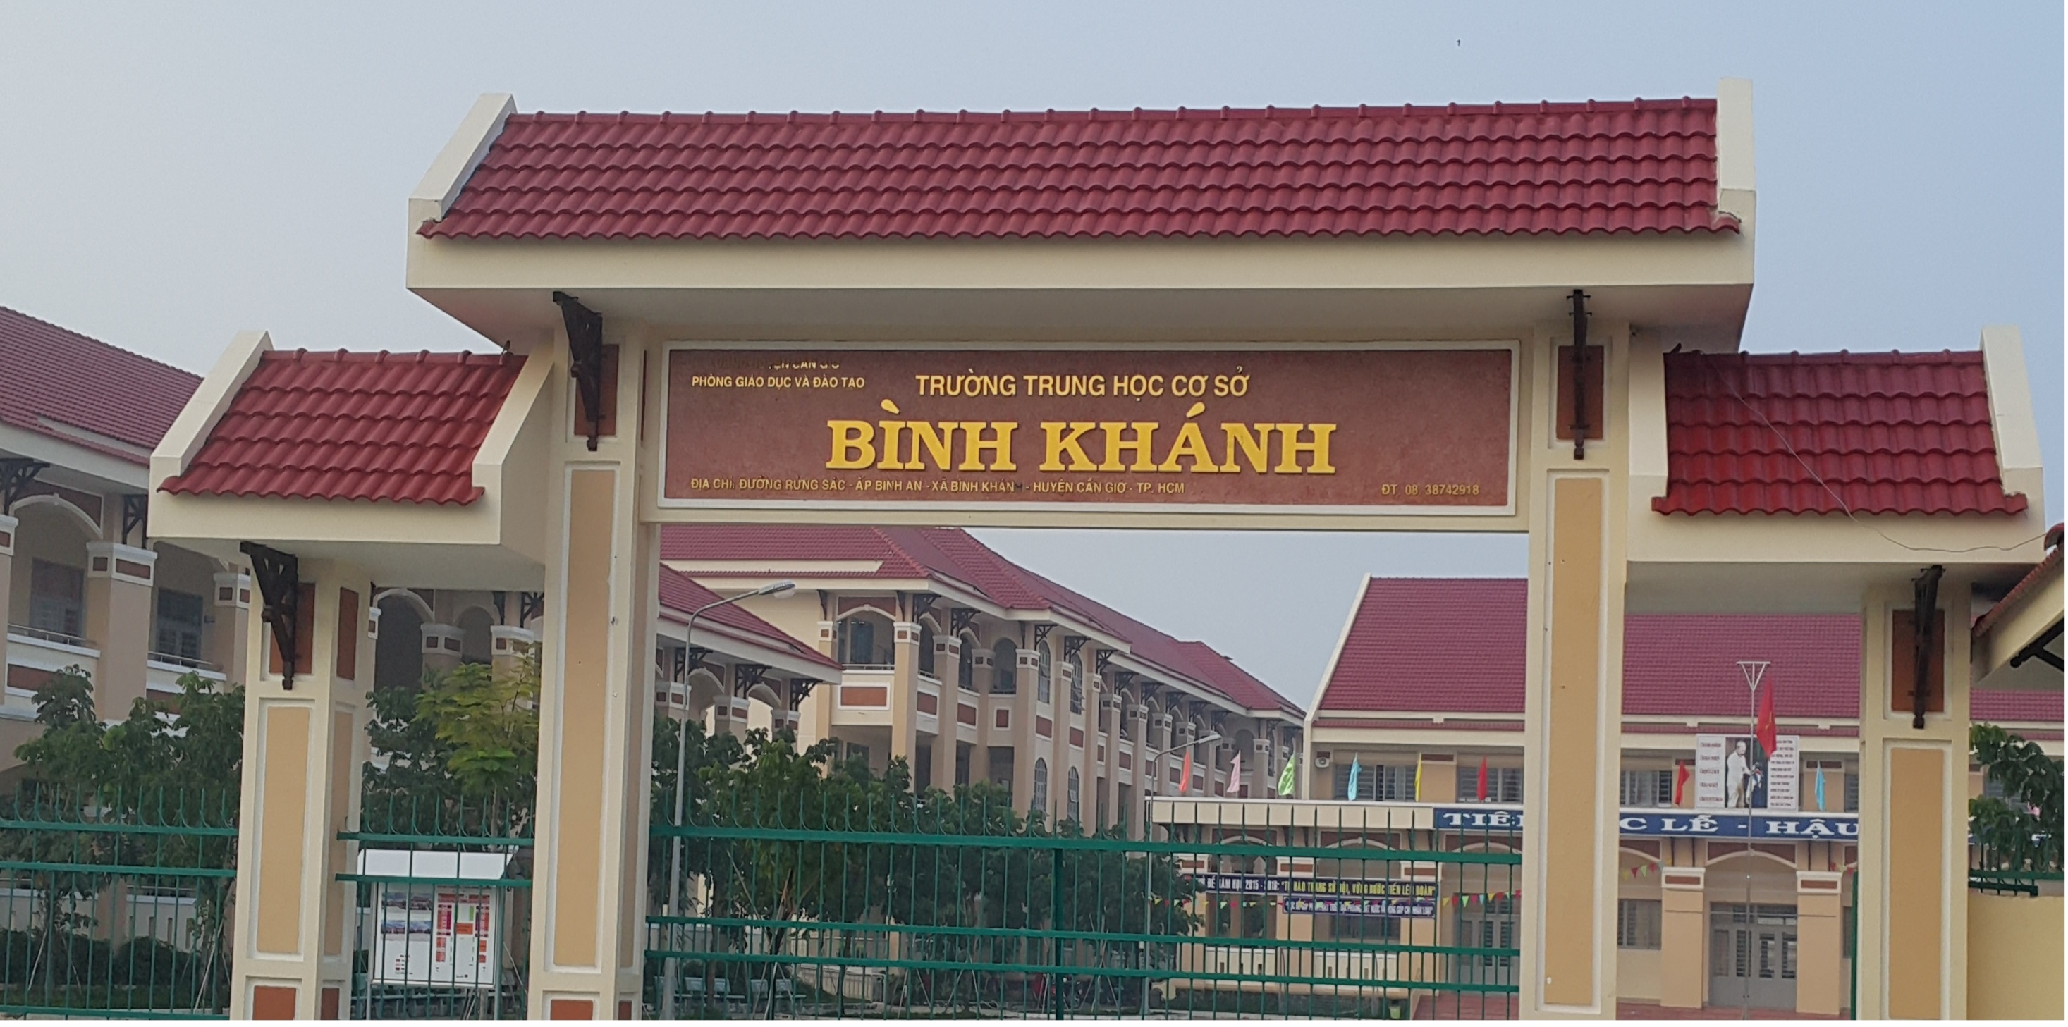
BINH KHANH SECONDARY SCHOOL
ENGLISH 6

Slide 2


Slide 3
MEMORY GAME

Slide 4

1 – 8
4
1
2
Yes, it can
Are you learning English?
Can a scorpion
kill a human?
3
Let’s go to the
costume
competition!
5
6
7
How big can a
gorilla grow?
Ok. great
195
No, we aren’t
8
What colour is
the crocodile?
9
How many
countries are
there
in the world?
10
11
Green and
brown
250 kilos
12

Slide 5
What can you do if you can’t remember a word in English?

Slide 6
UNIT 4:
LEARNING WORLD
Lesson 6 - SPEAKING
ASKING FOR HELP WHEN YOU’RE STUDYING

Slide 7
EXERCISE 1
1. Can you help me with something, please?
2. How do you say
3. Can you say that again, please?
4. How do you spell that?
The word Zac can’t remember is ‘tomorrow’.

Slide 8
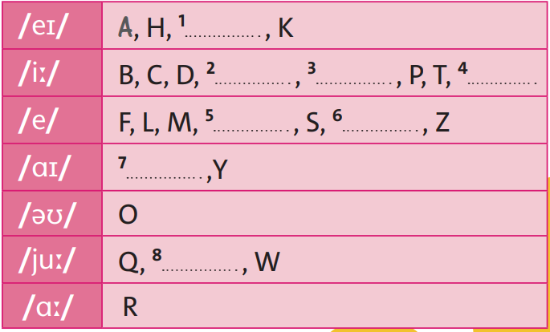

J
E
G
V
N
X
I
U

Slide 9
secondary
television
expensive
elephant
protect

Slide 10
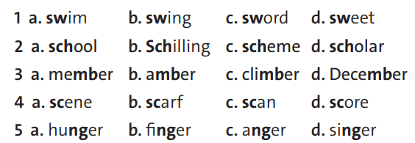
/sw/
/sw/
/sɔːrd/
/sw/
/sk/
/ˈʃɪl.ɪŋ/
/sk/
/sk/
/ˈmem.bɚ/
/ˈæm.bɚ/
/ˈklaɪ.mɚ/
/dɪˈsem.bɚ/
/siːn/
/sk/
/sk/
/sk/

Slide 11
/ˈhʌŋ.ɡɚ/
/ˈæŋ.ɡɚ/
/ˈæŋ.ɡɚ/
/ˈsɪŋ.ɚ/

Slide 12


Slide 13
A: Can you help me with something, please?
B: ...
A: How do you say … in English?
B: ...
A: Can you say that again, please?
B: ...
A: How do you spell that?
B: ...
A: Great. Thanks, … .

Slide 14
HOMEWORK
- Do exercise in Student book page 61.
Students prepare for the next lesson:
WRITING • An email about your school

