Slide 1
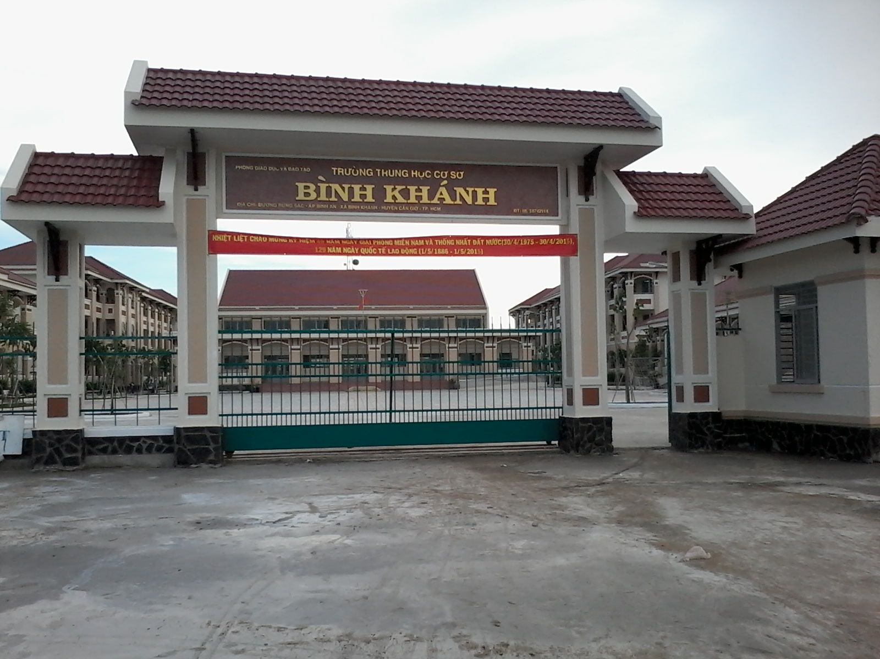



BINH KHANH SECONDARY SCHOOL
FRIENDS PLUS 6

Slide 2

UNIT 2: PUZZLES AND GAMES

Slide 3


Slide 4
LUCKY NUMBERS
1
2
3
4
5
6
7
8
9

Slide 5
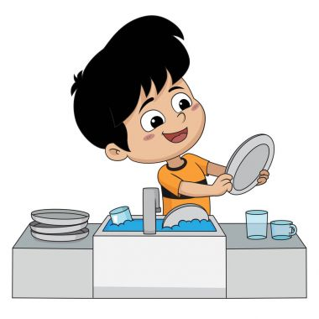
What activity is it?
wash the dishes

Slide 6

What activity is it?
do the laundry

Slide 7


Slide 8
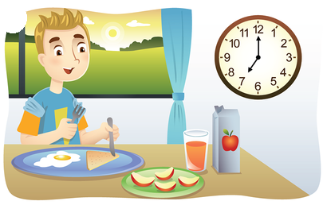
What activity is it?
have breakfast

Slide 9

What activity is it?
go to school

Slide 10

What activity is it?
do the housework

Slide 12
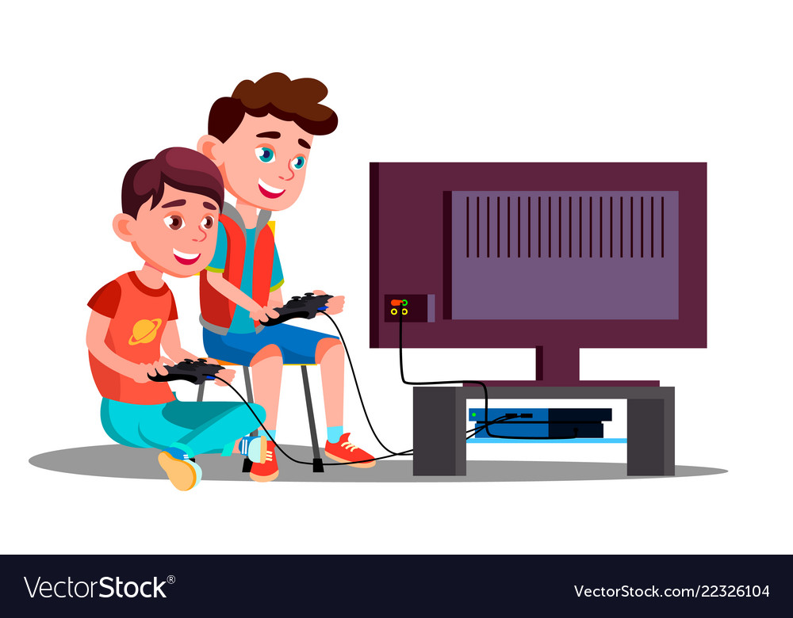
What activity is it?
playing video games

Slide 13
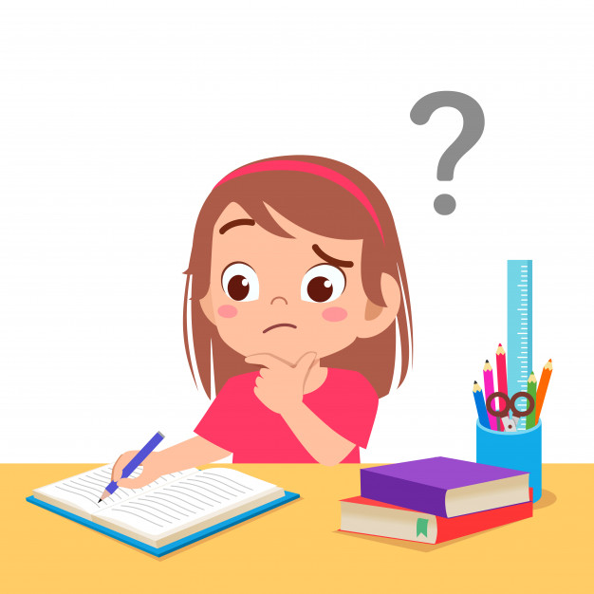
What activity is it?
do homework

Slide 14
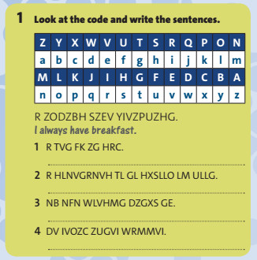
1/ Look at the code and write the sentences:
I get up at six.
1/ R TVG FK ZG HRC. -> ____________
2/ R HLNVGRNVH TL GL HXSLLO LM ULLG.
-> ____________________________
I sometimes go to school on foot.
My mum doesn’t watch TV.
3/ NB NFN WLVHMG DZGXS GE. -> _______________________
4/ DV IVOZC ZUGVI WRMMVI. -> __________________
We relax after dinner.

Slide 15
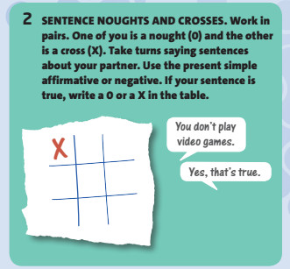
X
Student A: You don’t play video games.
Student B: Yes, that’s true.
Noughts “O” and
Crosses “X”

Slide 16
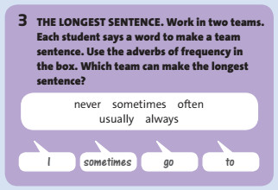
never
sometimes
often
usually
always
I
sometimes
go
to
...........
the 1st student:
the 2nd student:
the 3rd student:
the 4t^{h} student:
the... student:

Slide 17
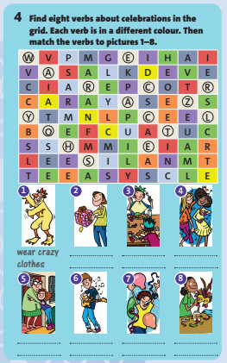
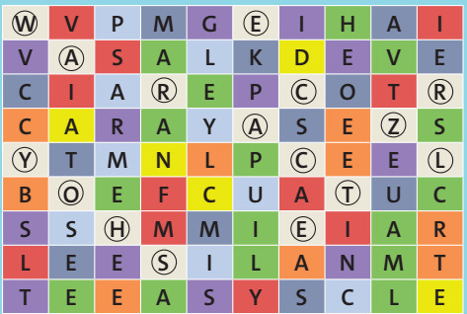

Slide 18
____ ______
give presents

Slide 19
_____ ______
______ _____
have a
special meal

Slide 20
_________
dance

Slide 21
____ ______
visit family

Slide 22
___ ____
play music

Slide 23
________
celebrate

Slide 24
make costumes
_____ _____

Slide 25

Example:
Student A: Where do you live?
Student B: I live in Ankara.
Where
What
Who
When
How
do
like
work
speak
help
play
eat
live

Slide 26

* Homework: - Review the grammar structures and new words of unit 2. - Complete the progress review 1 on page 34.

