Slide 1
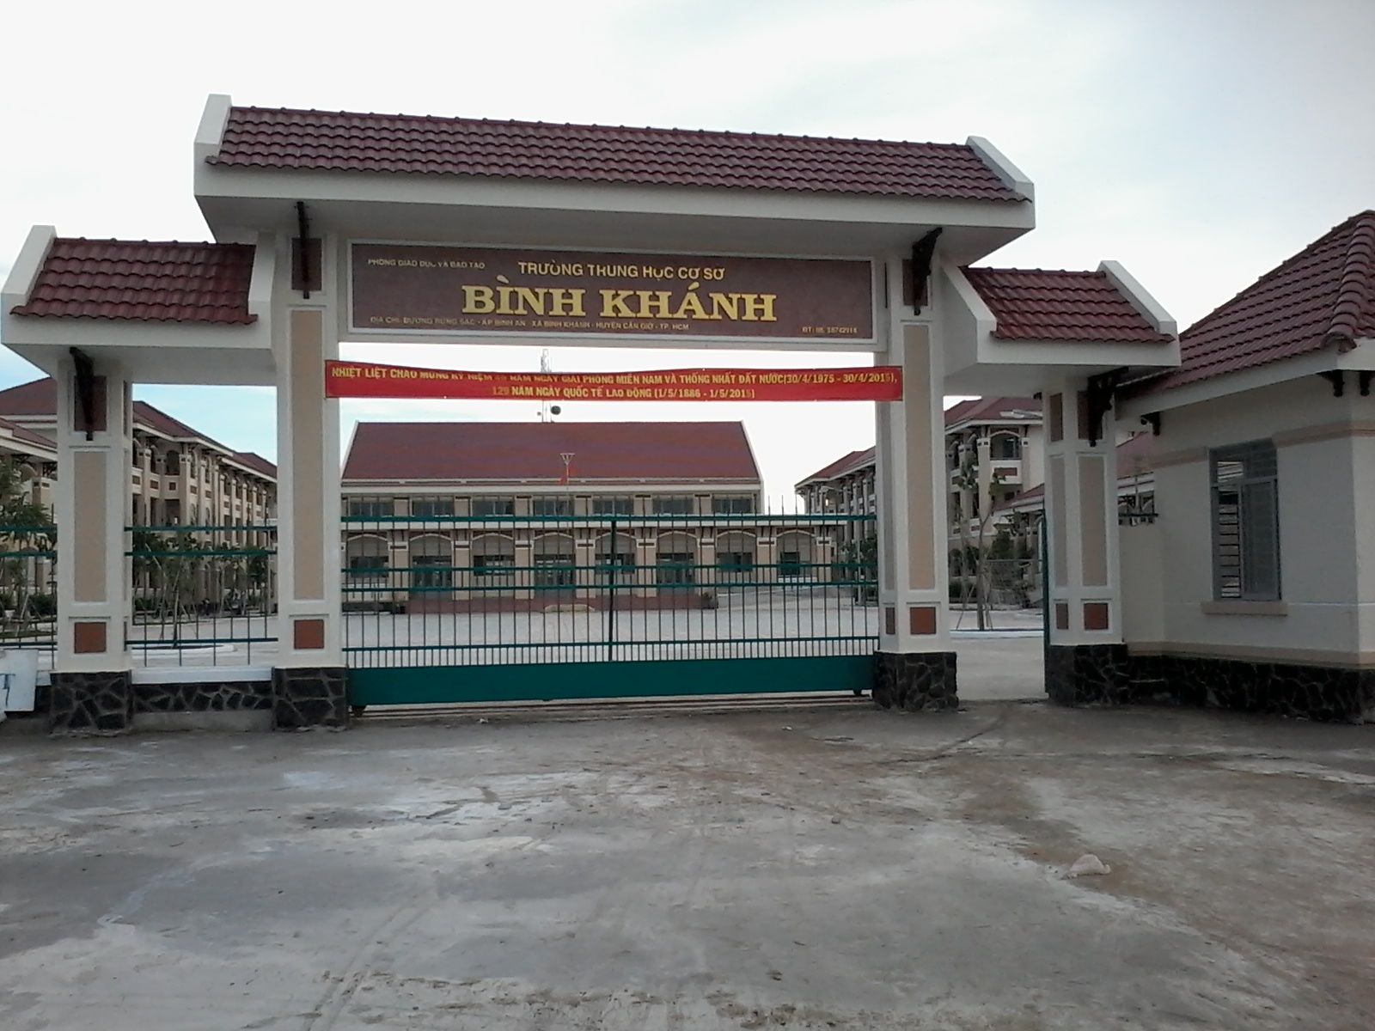



BINH KHANH SECONDARY SCHOOL
FRIENDS PLUS 6

Slide 2
Jigsaw puzzle game
PIC.1
PIC.2
PIC.3
PIC.5
PIC.4

Slide 3
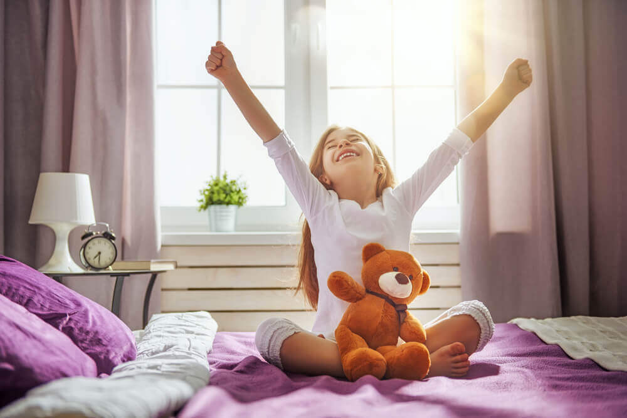
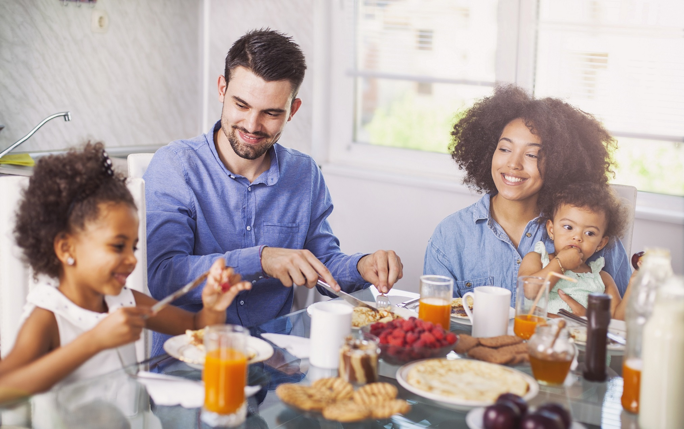
have breakfast
get up

Slide 4
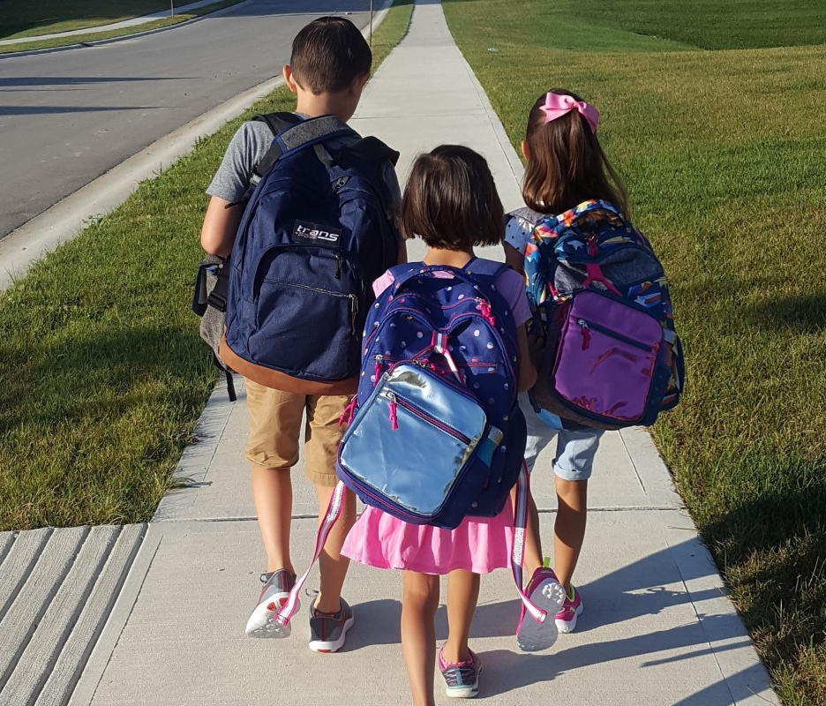
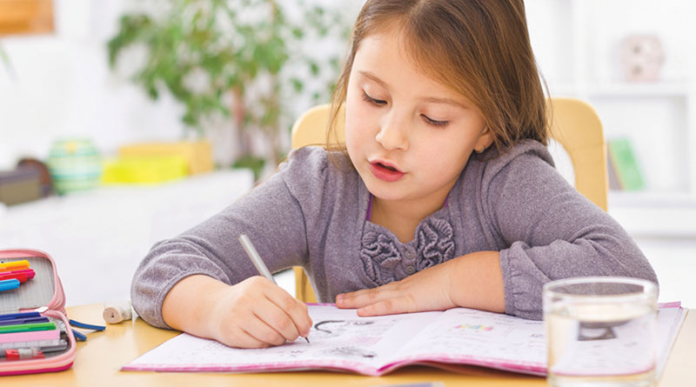
do homework
go to school

Slide 5
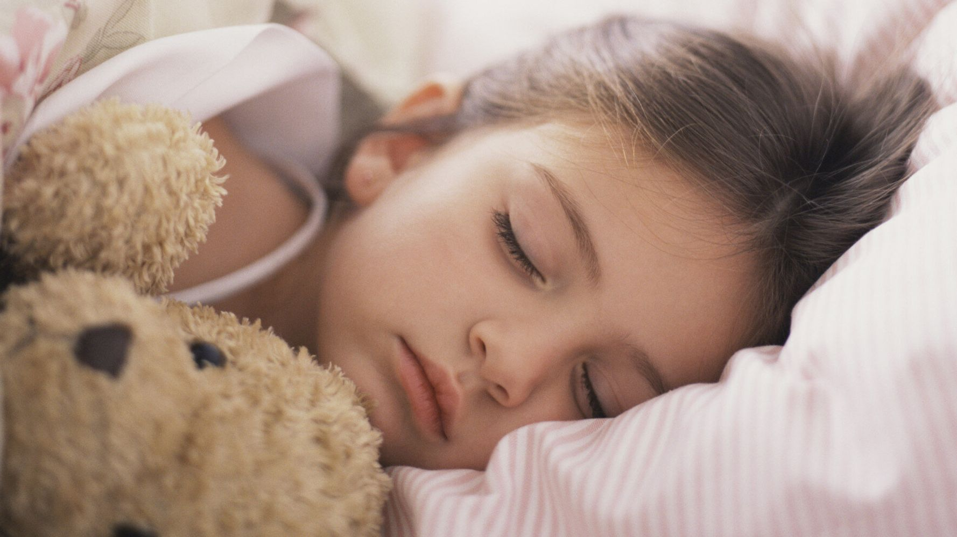
What are these pictures about?
go to bed

Slide 6
UNIT 2: DAYS
Lesson 1
VOCABULARY • Daily routines

Slide 7
New words
get up (n) /ˈɡet̬.ʌp/
go to bed (n)
have breakfast / lunch / dinner (n) /ˈbrek.fəst/ /lʌntʃ/ /ˈdɪn.ɚ/
- go to school (n) /skuːl/

Slide 8
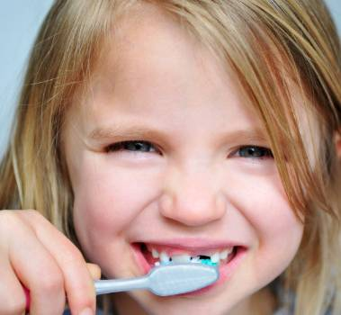
brush one’s
teeth (n) /brʌʃ/

Slide 9
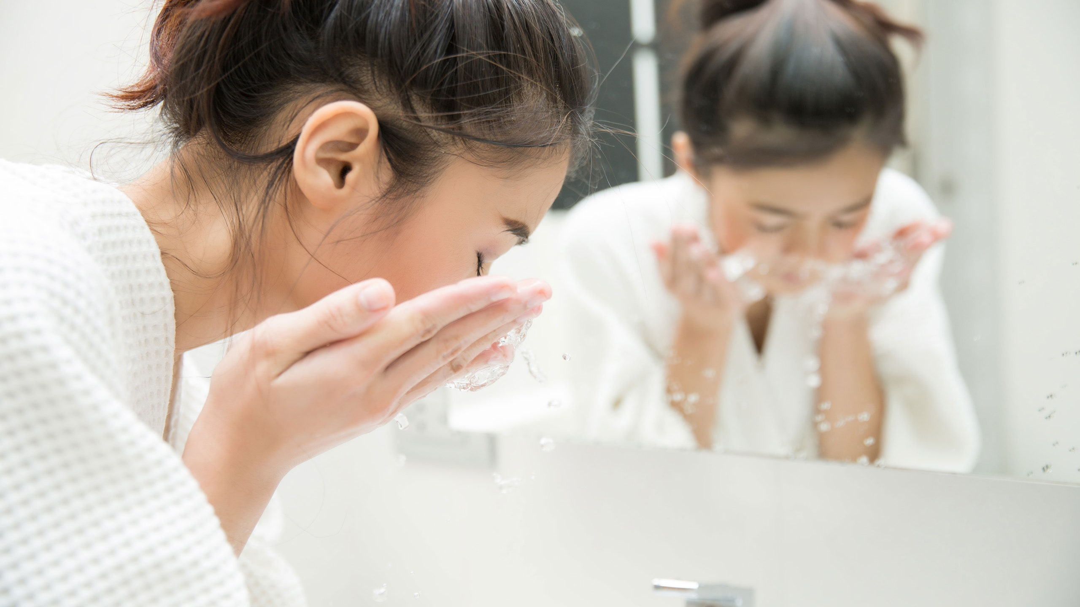
wash one’s face

Slide 10
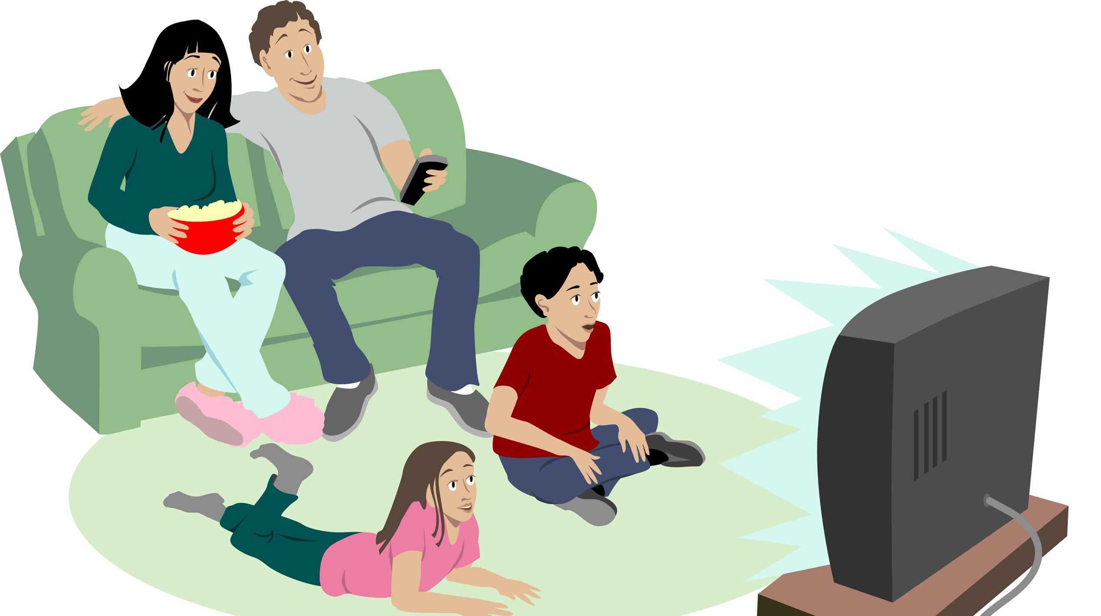
watch TV : /wɑːtʃ/

Slide 11
New words
have classes :
Ex: Students have classes on Monday morning.
study (v) /ˈstʌd.i/

Slide 12


Start / Finish the day:
get up, brush my teeth, wash my face, go to bed, sleep
Eat:
have breakfast
/ lunch / dinner

Slide 13
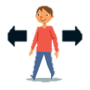

Free time:
watch TV,
relax, play video
games, chat online
Travel:
go to school,
get home

Slide 14

Work and study: study, have classes,
do their homework, help with the
housework.

Slide 15
ACTIVITY 2
1 True 2 True
9 False 10 True
3 True 4 False
11 False 12 False
5 False 6 True
7 False 8 True

Slide 16
I always do my homework.
100%
normally/usually
90%
often
75%
sometimes
50%
never
0%
0%

Slide 17
New words
always (adv)
every time or all the time
normally / usually (adv)
in the way that most often happens

Slide 18
New words
often (adv)
many times
sometimes (adv)
not always or often
never (adv)
not at any time

Slide 19
Language note - Adverbs of frequency
Usage: to say how often we do things, or how often things happen.

Slide 20
Ex: a) I always have breakfast.
ordinary verbs
b) You are always late.
verb be

Slide 21
Rules
Adverbs of frequency come …
1. after the verb be.
2. before other verbs.

Slide 22
Practice
1. Jo goes always to school on foot.
2. The bus often is late.
3. I never watch TV.
4. People in this school are usually friendly.
5. She normally doesn’t walk to school.

Slide 23
Answer key
1. Jo always goes to school on foot.
2. The bus is often late.
3. correct
4. correct
5. She doesn’t normally walk to school.

Slide 24


Slide 25
Talk about favorite day
a favorite day/ special day
activities in a day (get up, get dressed..)
time (at least 2 activities)
the activity they like best

Slide 26
HOMEWORK
- Do exercise in workbook page 20
- Prepare for the next lesson: Reading - A busy day.
+ Answer the question: What things do you do with your brother / sister?

