Slide 1
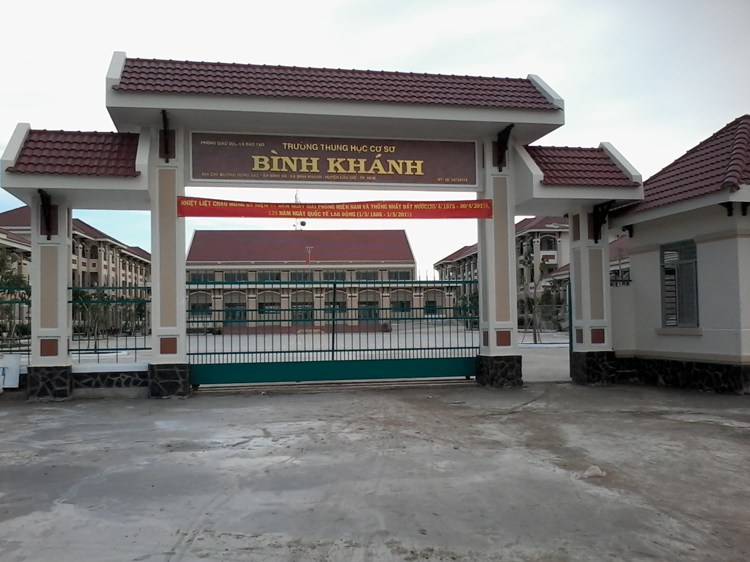
BINH KHANH SECONDARY SCHOOL
FRIENDS PLUS 6

Slide 2
UNIT 1: PUZZLES AND GAMES

Slide 3
GUESSING GAME
* Game rules:
-Teacher invites 1 student to come in front of the class.
- He/She has to use phrases or give examples to explain the words that given by teacher.
-Teacher invites some students to answer.

Slide 4
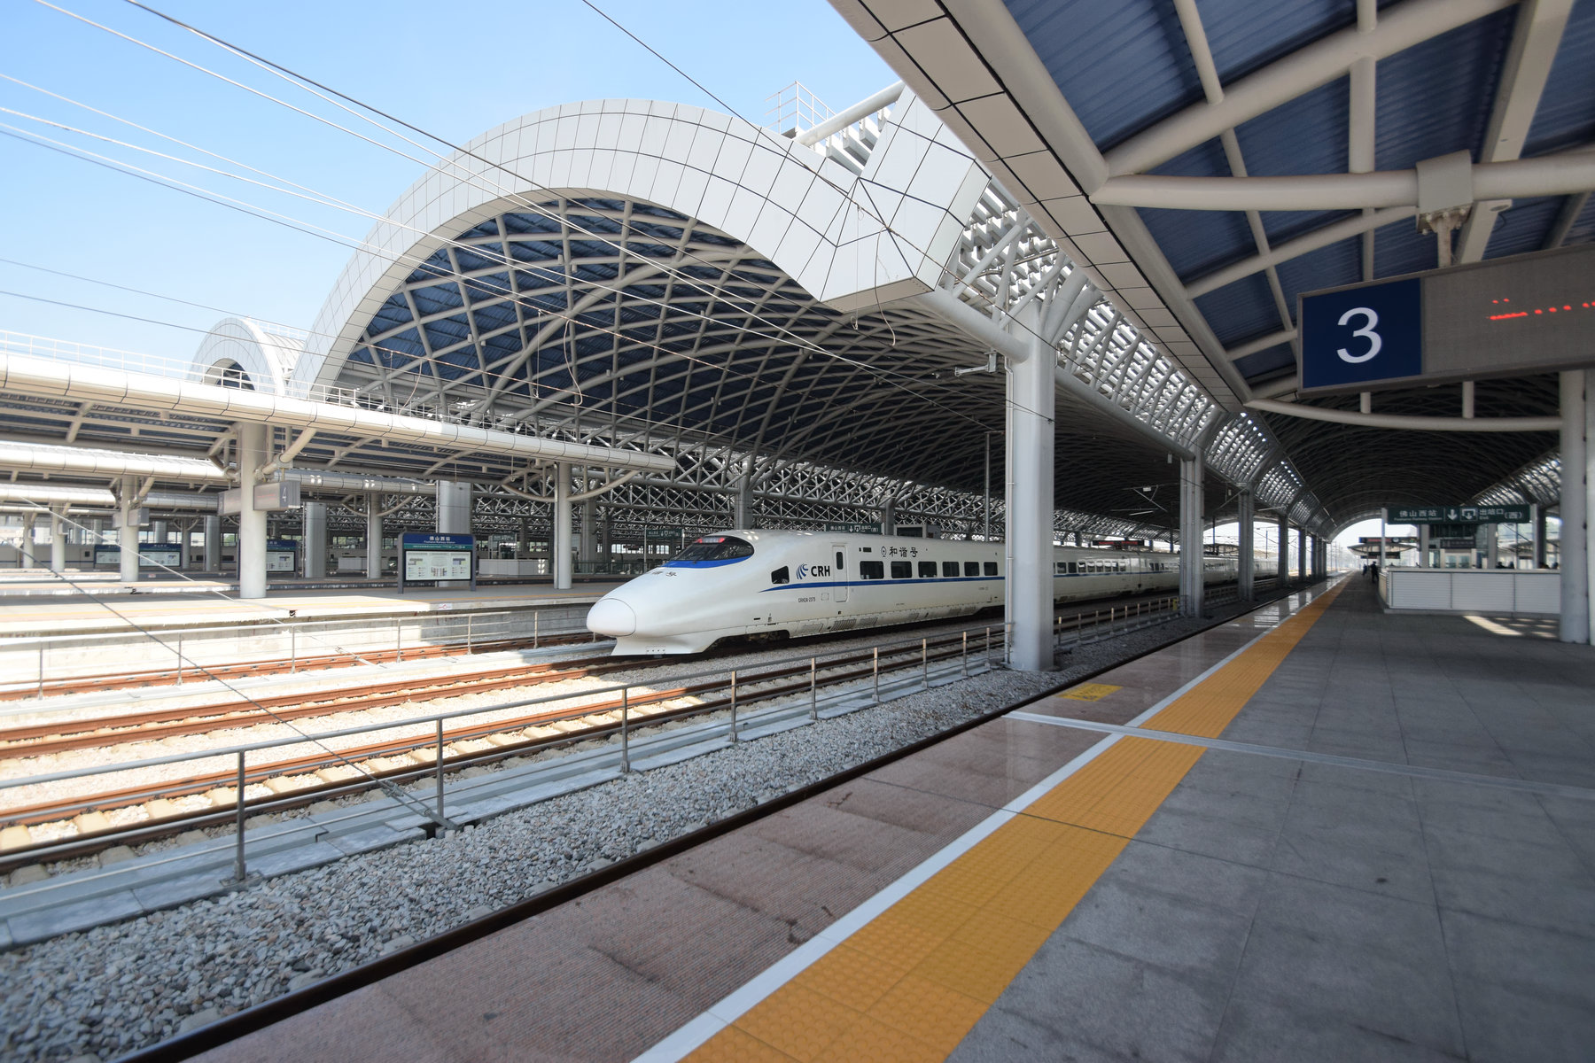
1/ London
2/ cruise
3/ map
4/ station

Slide 5
A
R
K
E
E
S
Q
A
E
T
A
F
U
L
B
R
R
A
I
N
M
T
E
T
E

Slide 6
* GUESS THE SENTENCE:
GAME RULES:
-Invite a confident student to come to the board and write the first letter of each word in their sentence.
-Other students guess the sentence.
For example:

Slide 7
For example:

Slide 8
1/ There’s a cinema on map A, but
a theatre on map B.
2/ There’s a train station on map A, but a bus stop on map B.
3/ There’s a shopping centre on map A, but a sports centre on map B.
4/ There are two restaurants on map A, but only one on map B.
5/ There are two cafés on map A, but three on map B.
6/ There isn’t a monument in the park on map A, but there is on map B.

Slide 9
1/ friendly
2/ clean
3/ dangerous
4/ modern
5/ ugly
6/ expensive

Slide 10
*COMPARATIVE BINGO:
friendly, quiet, clean, pretty, old, dangerous, dirty, ugly, small,
big, bad, exciting
clean
exciting
small
exciting
pretty
dangerous

Slide 11
* Homework: - Review the grammar structures and new words of unit 2. - Prepare for next lesson – Language focus: comparative adjectives

