Slide 1
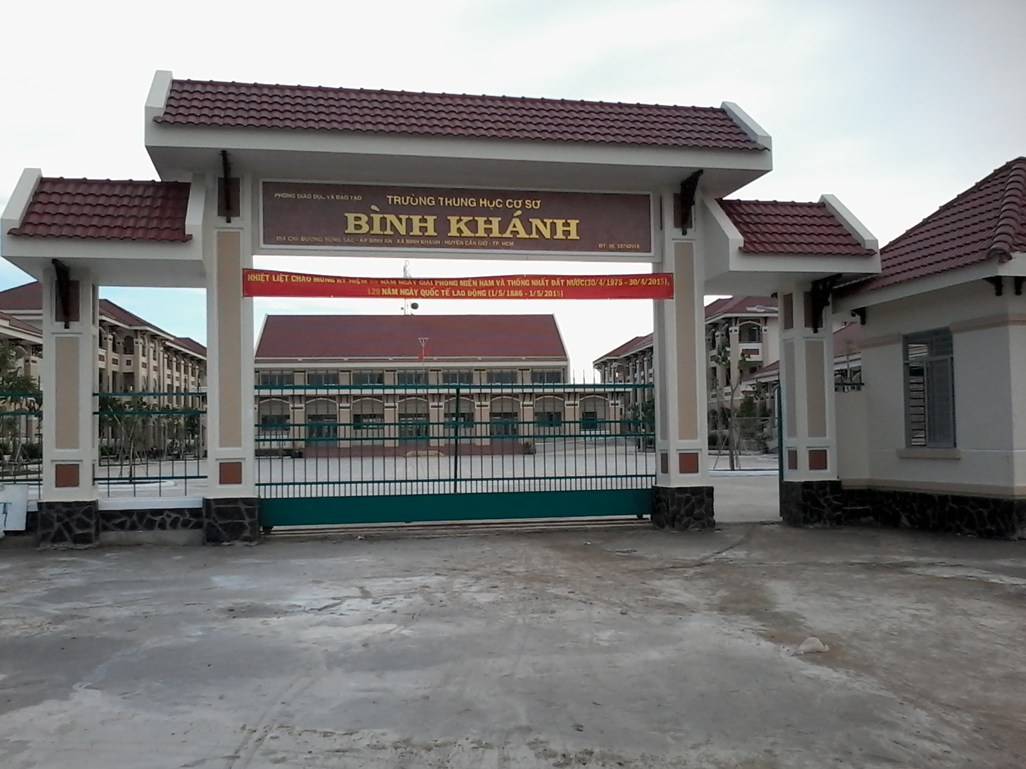
BINH KHANH SECONDARY SCHOOL
FRIENDS PLUS 6

Slide 2
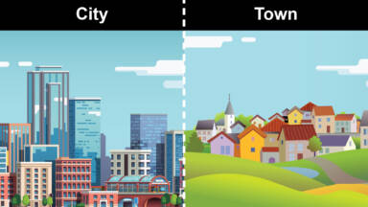
UNIT 1: TOWNS and CITIES
LESSON 6: SPEAKING

Slide 3
GUESSING GAME!

Slide 4
You are a tourist in a new town.
Where do you look for information and direction?

Slide 5
EXERCISE 1: Complete the dialogue with the phrases in the box. Then watch or listen and check. Are Chris and the woman from the same town?
any shops the bus station Are we near five minutes
Are we near
the bus station
any shops
five minutes

Slide 6
EXERCISE 2: Watch or listen again. Then practise the dialogue in pairs.
Are we near
the bus station
any shops
five minutes

Slide 7
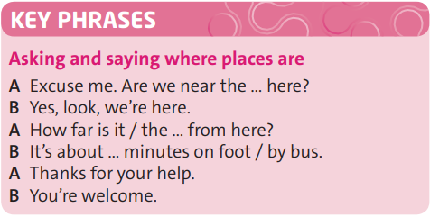
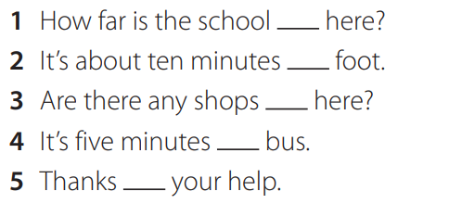
EXERCISE 3: Read the study strategy and follow the instructions.
Work in pairs to complete the sentences with the correct prepositions.
from
on
around
by
for

Slide 8
EXERCISE 4: Work in pairs. Practise mini-dialogues with How far … ? and places 1–4.
Example:
Excuse me, how far is the bus station from here? (What is the distance between here and the bus station?)
It’s about ten minutes on foot.
Thanks for your help.
You’re welcome.

Slide 9
EXERCISE 5: Work in pairs. Look at the situation and prepare a new dialogue. Use the dialogue in exercise 1 to help you.
Group A: give the questions
Group B: give the answers.

Slide 10
- Learn by heart all the new words
- Prepare for next lesson

