Slide 1
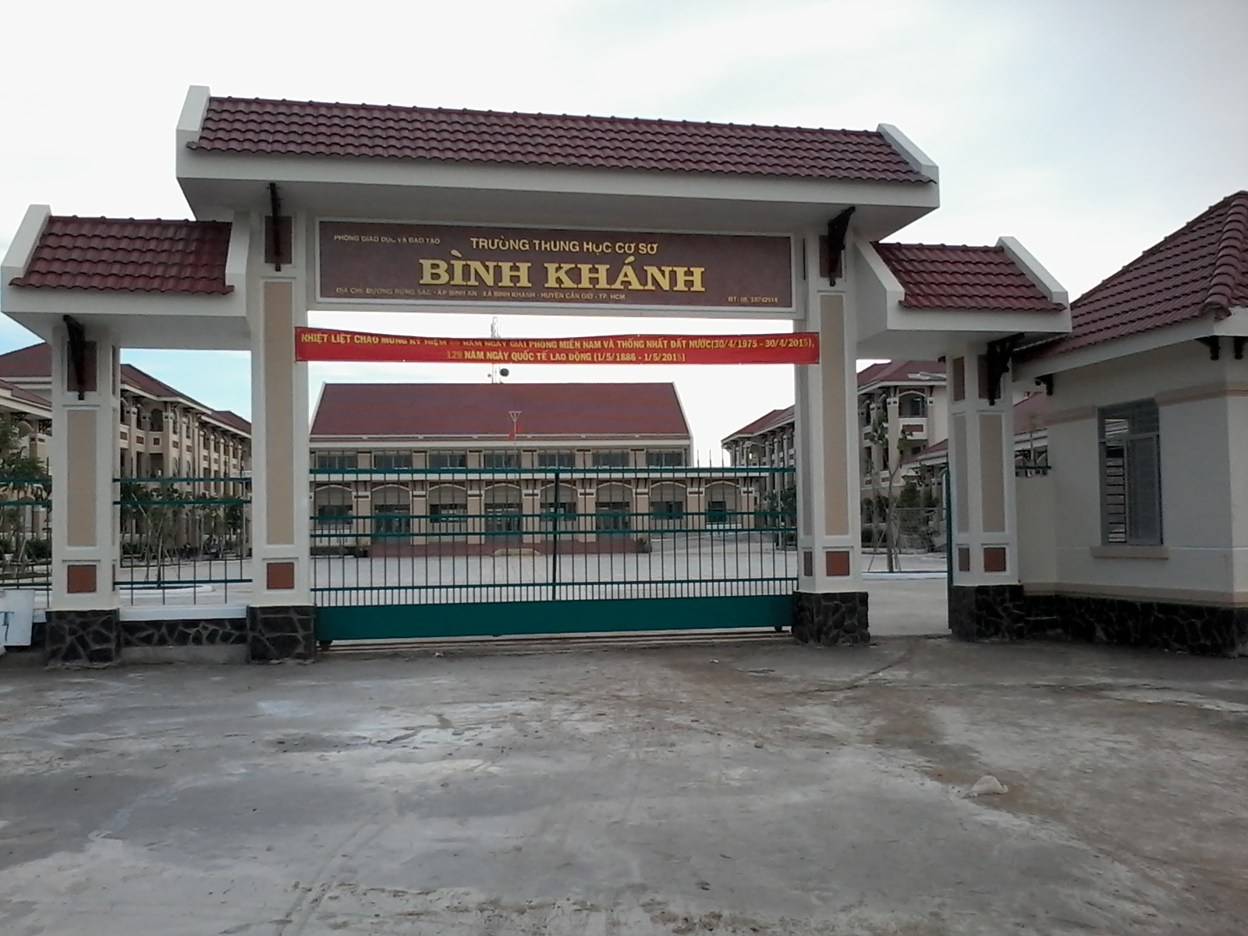
BINH KHANH SECONDARY SCHOOL
FRIENDS PLUS 6

Slide 2
Noughts and crosses

Slide 3
swimming pools
library
2000
climbing wall
250
school
park
20
6360

Slide 4
UNIT 1
TOWNS AND CITIES
Lesson 3: language focus

Slide 5
Complete the questions. Then choose the correct answers.
Is
1) ______ there a school on the ship?
A. Yes, there is.
B. No, there isn’t.
Are
2) ______there any swimming pools?
A. Yes, there are.
B. No, there aren’t.
are
3) How many cafés and restaurants _____ there on the ship?
A. Yes, there are.
B. There are twenty.

Slide 7
THERE IS (= There’s)
(+) :
There is + a / an + singular Noun
Ex: There is a pen on the desk.
(-) :
There is + NOT + a / an + singular Noun
Ex: There is not a buffalo in the rice field.
(= isn’t)

Slide 8
(?) :
Is there + a/an + singular Noun?
→ Yes, there is. / No, there isn’t.
Ex: Is there an eraser in your school bag?
No, there is not.

Slide 9
2) THERE ARE (= There’re)
(+) :
There are + plural Noun
Ex: There are three apples in the picnic basket.
(-) :
There are + NOT + ANY + plural noun
Ex: There are not any books on the desk.
( = there aren’t)

Slide 10
(?) :
Are there + ANY + plural noun?
➔ Yes, there are. / No, there aren’t.
Ex: Are there any swimming pools on the ship?
➔ Yes, there are.
How many + plural Noun + are there…..?
Ex: How many chefs are there on the ship?
➔ There are 50 chefs.

Slide 11
Choose the correct words in the Rules.

Slide 12
1. We use in questions.
some /
any
2. We use Yes, there is and No, there isn’t with
singular nouns
/
plural nouns.
3. We use Yes, there are and No, there aren’t with
plural nouns
.
singular nouns /
plural nouns
.
4. We use How many … ? with
singular nouns /
plural nouns.

Slide 13
1) Is there a | a) people are there?
2) Are there | b) a good school?
3) Is there an | c) sports centre?
4) How many | d) bridges?
5) Is there | e) old part?
6) Are there any | f) any five-star hotels?

Slide 14
Complete the questions with IS THERE … ? , ARE THERE … ? and HOW MANY … ?.

Slide 15
Are there
1) ___________any trees in your town or city?
Is there
2) __________ a park or a sports centre?
How many
3) _____________ swimming pools are there?
Are there
4) ____________ any exciting places for young people?
How many
5) _____________ people live in your town?

Slide 16
DEFINITE AND ZERO ARTICLE
We use “the” to talk about a particular thing.
We use “zero article” to talk about things in general.

Slide 17
Complete the sentences with the or ⏀.
the
1) There are a lot of things to do on ______ cruise ship.
the
2) I go running in _______ park near my house.
⏀
3) I think _______ climbing is an exciting sport.
⏀
4) My dad likes cooking _______ food.
the
5) There are lots of boats at ________ Cai Rang floating market.

Slide 18
“I WANT TO BE A DESIGNER”

Slide 19
Let’s design your dream amusement park.

Slide 20
Homework
- Learn by heart all structures.
- Write a description of your amusement park. Use the preposition in the Starter Unit.

