Slide 1


TiẾNG ANH TĂNG CƯỜNG
KHỐi 7
Tuần : 3 & 4

Slide 2
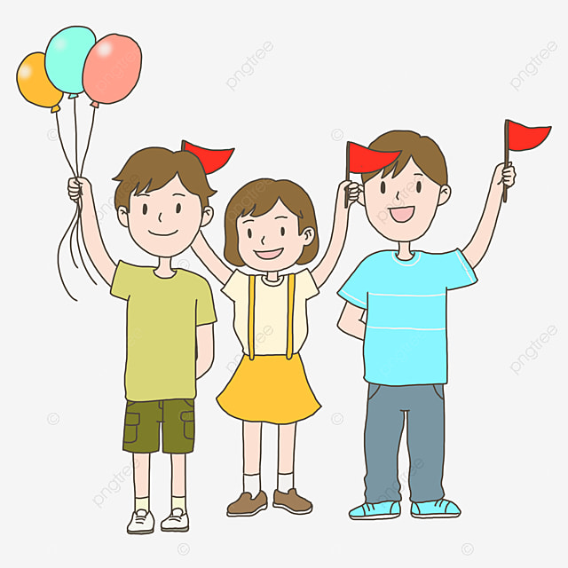
REVISION

Slide 3
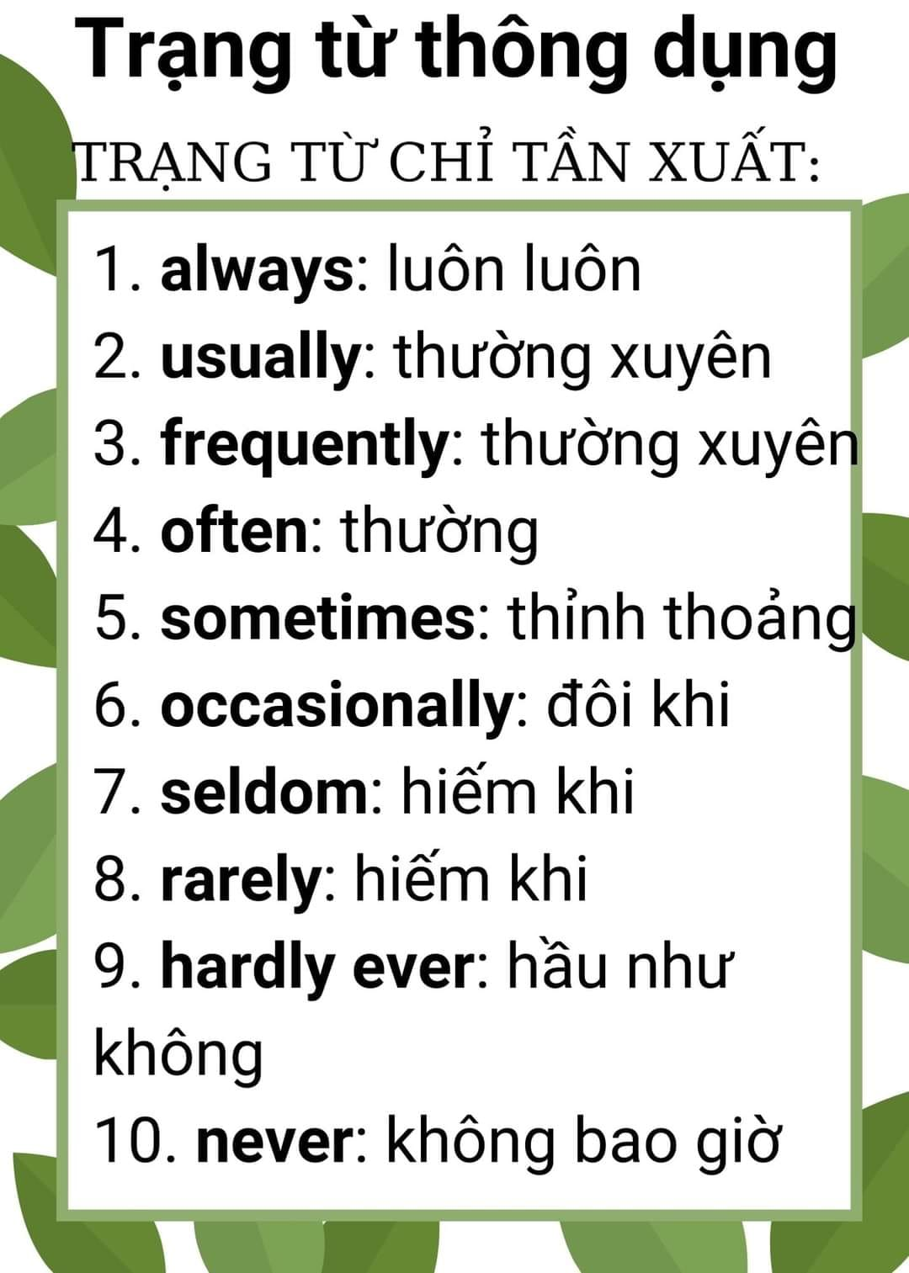

Slide 4
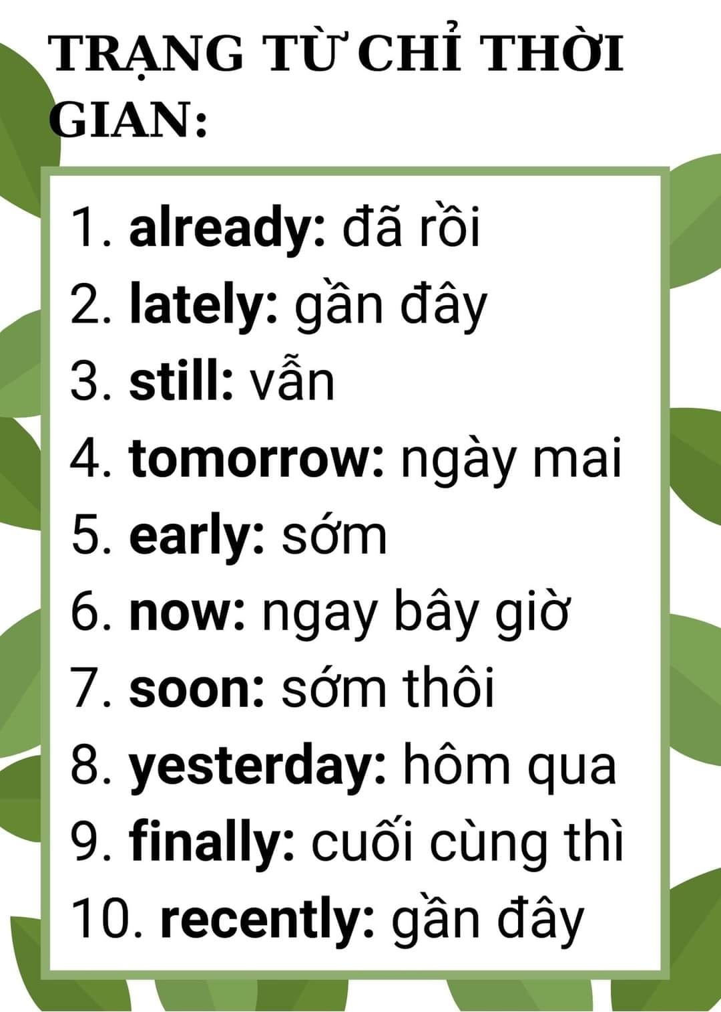

Slide 5
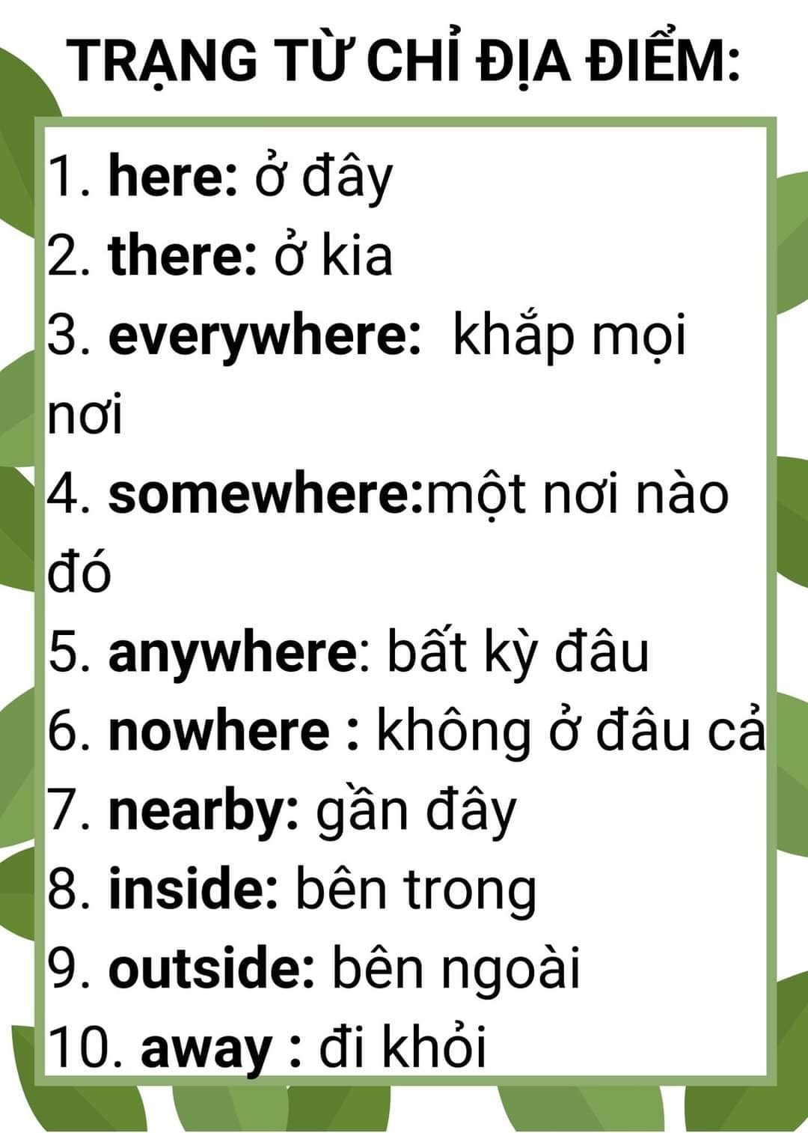

Slide 6
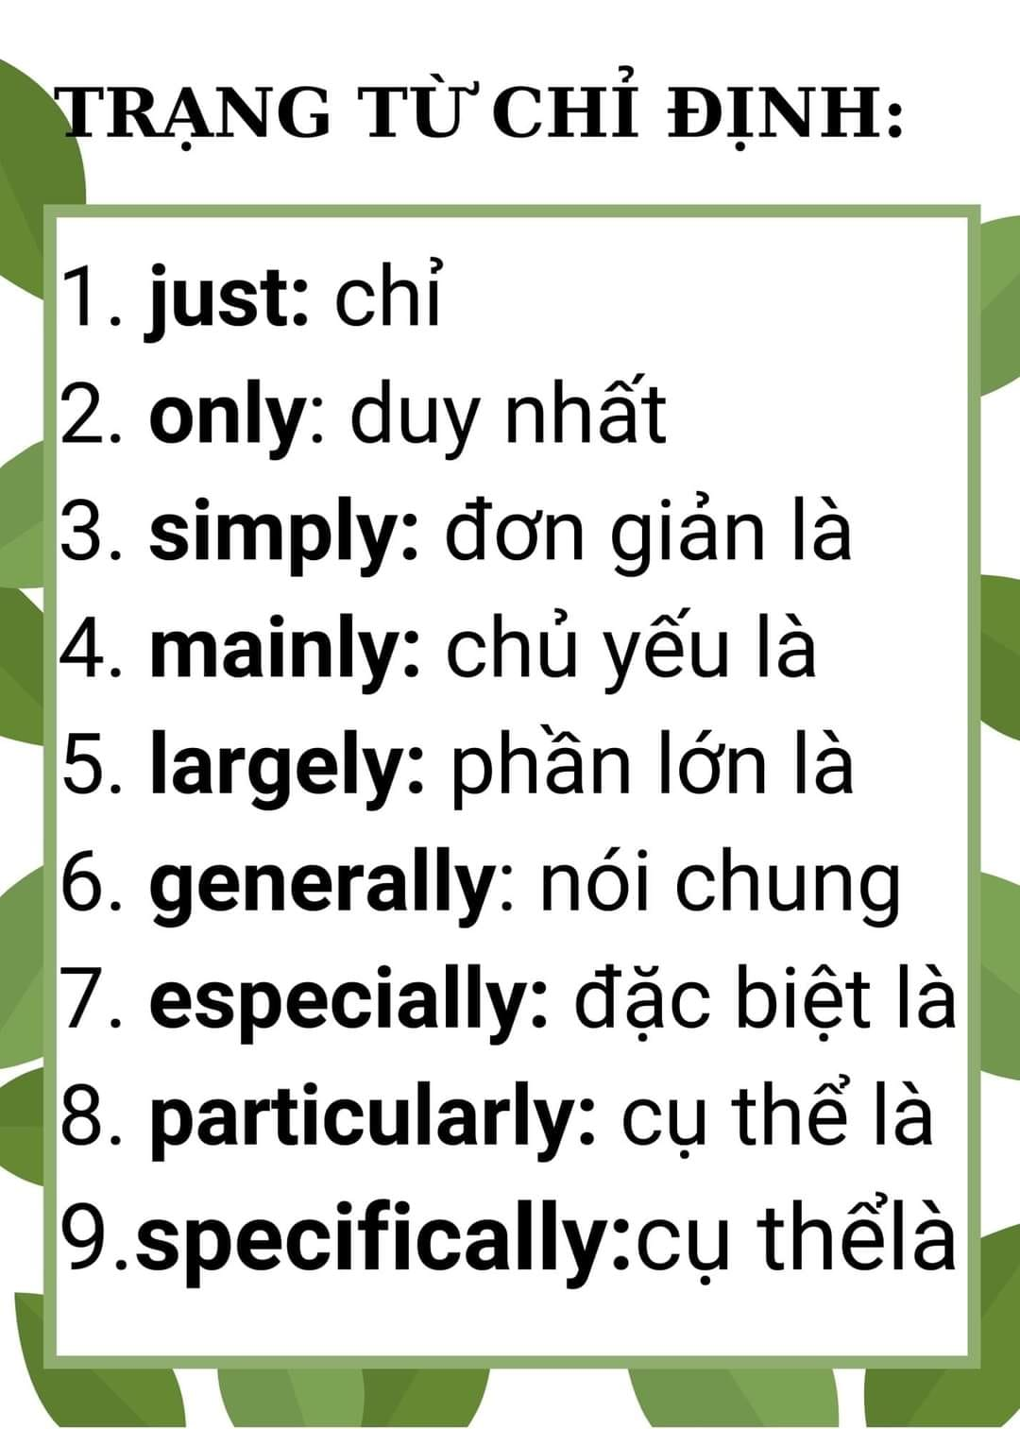

Slide 7
EXERCISES:
A/ Put the words in the correct order to form complete sentences.
1/ flying / Are / the children / a kite? ____________________________.
2/ birthday / is / He / celebrating/ his ____________________________.
3/ John / taking / is / pictures __________________________.
4/ isn’t / She / a costume / wearing ________________________.
5/ a contest / We / watching / are ________________________.
6/ now / it / raining / Is? ______________________________.
B/ Choose the correct answer:
7/ The festival _____ in the evening. (is starting / starting / starts)
8/ Rita _____ to a party today. (is going / goes / going)
9/ It usually _____ in the winter. (is raining / rains / rain)
10/ Do you ______ my new dress? (likes / liking / like)
11/ We _____ ice-skating this afternoon. (goes / are going / go)
12/ _____ George doing his homework? (Is / Does / Do)
13/ Mary and Dan _____ to school on foot. (goes / going / go)
14/ He _____ like chocolate cake. (doesn’t / don’t / isn’t)
15/ Where _____she live? (has / does / is)

Slide 8
C/ Put the verbs in the parentheses in the simple past.
In my dream, the sun (16) _______ (shine). My friends and I (17) ______ (wear) our bathing suits. I (18) _______ (swim) in the ocean, and my best friend (19) ________
(make) a sandcastle. My other friends (20) _________ (play) beach volleyball. We (21)
_______ (enjoy) ourselves very much.
D/ Using the correct form of the words in the parentheses:
22/ She is _________ in the kitchen now. (cook)
23/ HCM City is ________ than Ha Noi. (big)
24/ He is ________ because he has a bad mark. (happy)
25/ My mother ________ jogging every morning. (go)
26/ Minh is a new comer but she is ________. (friend)
27/ They are ________ for the bus at the bus station. (wait)
E/ Rewrite:
28/ Nam is taller than any students in his class.
→Nam is ___________________________.
29/ The post office is near the city center.
→ The post office is not ________________________.
30/ My class has fifty students .
→ There are _________________________________.

Slide 9
F/ Fill in the banks with the appropriate adverbs of frequency to make the sentences true for you.
* never * sometimes * often * usually * always
31/ _______ make breakfast. 32/ _______ make my bed.
33/ _______ take out the garbage. 34/ _______ walk the dog.
35/ _______ water the plants. 36/ ________ go to the library.
37/ _______ go shopping. 38/ ________ play computer games.
G/ Complete the sentences with the correct verb, using the simple present:
*clear * set * mow * cook * take out * make * tidy up
38/ Jonathan always ________ his bed.
39/ _______ you _____ the table after dinner?
40/ Helen never _______ the lawn.
41/ His father hardly ever _______ dinner.
42/ _______ you always _______ the dog?
43/ Steve sometimes _______ the garbage.
44/ ________ Pete usually _________ the table before dinner?
45/ I always ________ my desk after I finish my homework.

Slide 10
H/ Rewrite:
46/ What’s your job?
→What _______________________?
47/Where do you live?
→What is ______________________?
48/ I get to work in an hour.
It takes _______________________.
49/ What’s your age?
How old _____________________?
50/ My book is cheaper than yours.
→Your book ____________________.
51/ No one can study better than Nam in class.
→Nam studies __________________________.
52/ There are forty students in our class.
→Our class has _________________________.
53/ What’s your surname?
What is _____________________________.
54/ Next Sunday is Hoa’s 14th birthday.
→Hoa will ____________________________.
55/ I run fast than my brother.
→My brother _________________________.

