Slide 2
Lesson 1
4
8
5
6
7
3
2
Notes:
Click on the words, they will move and match up with the pictures.

Slide 3
UNIT 2: SHOOL – Lesson 1 (period 1)
New words
No | Words |  | Meaning
1 | history | (n) | môn Lịch sử
2 | P.E. (Physical Education) | (n) | môn Thể dục
3 | I.T. (Information Technology) | (n) | môn Tin học
4 | music | (n) | môn Âm nhạc
5 | geography | (n) | môn Địa lý
6 | literature | (n) | môn Văn
7 | physics | (n) | môn Vật Lý
8 | biology | (n) | Môn Sinh học

Slide 4
Lesson 1
Sarah
art
P.E
geography
P.E

Slide 5
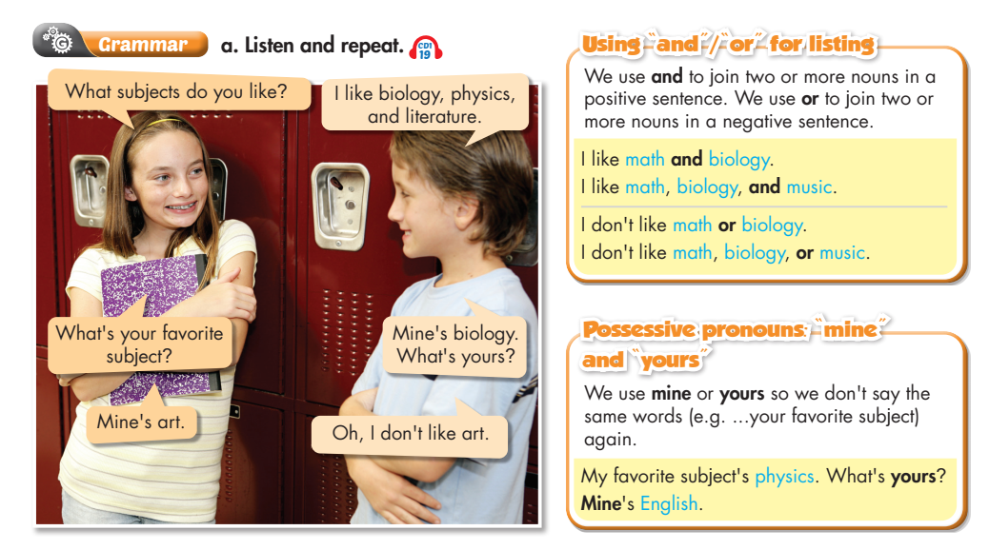
Lesson 1

Slide 6
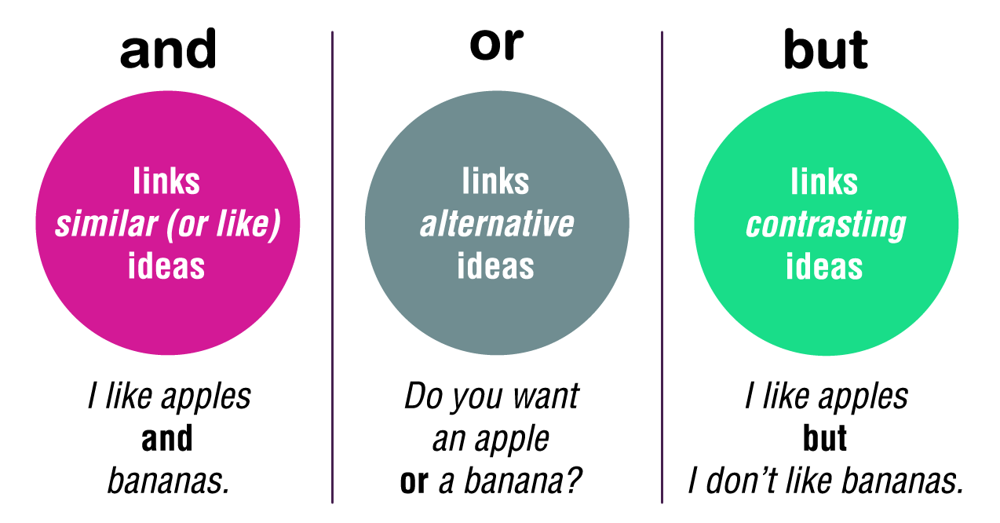
Lesson 1

Slide 7
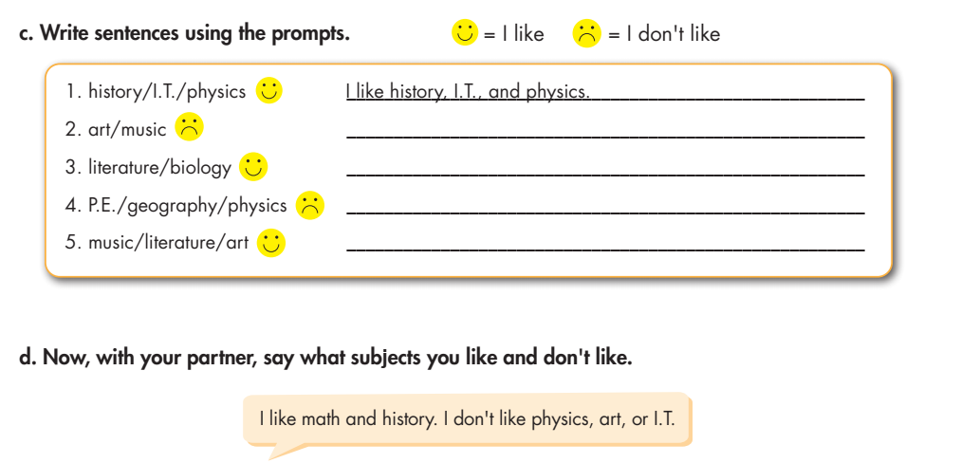
Lesson 1
I don’t like art or music.
I like literature and biology.
I don’t like P.E., geography or physics.
I like music, literature and art.

Slide 8
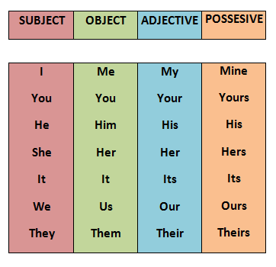
Lesson 1

Slide 9
Lesson 1

Slide 10
Lesson 1

Slide 11
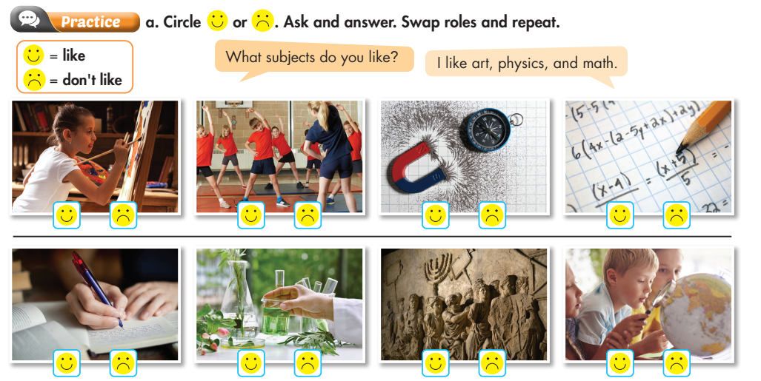
Lesson 1

Slide 12
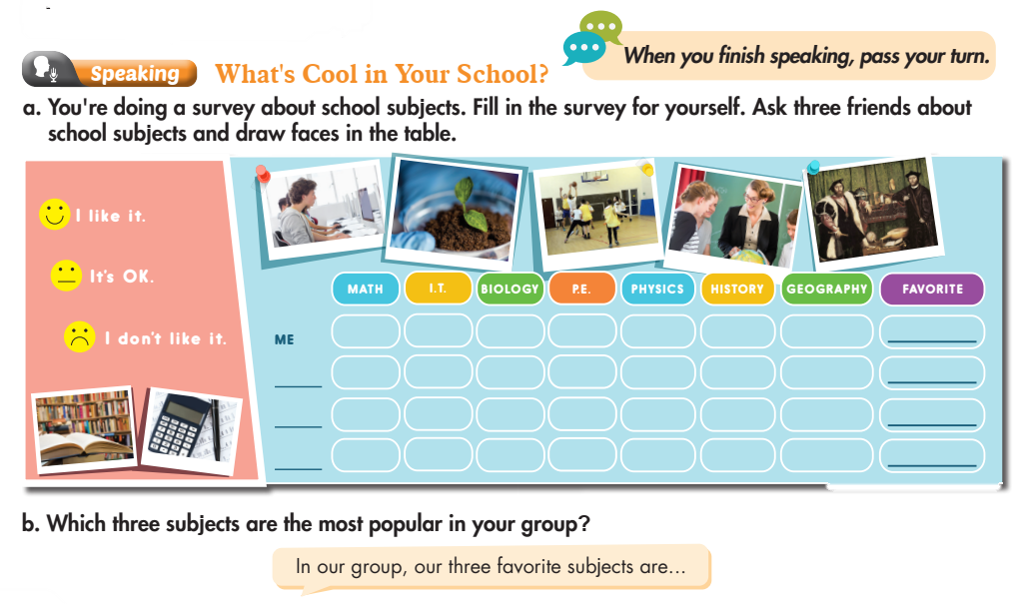
Lesson 1

Slide 13
Homework
HOMEWORK:
- Learn by heart and Write down 2 lines/ each word &
3 times/ grammar.
- Write five sentences about your favorite subject.

Slide 14
Lesson 2

Slide 15
UNIT 2: SHOOL – Lesson 1 (period 1)
New words
No | Words |  | Meaning
1 | activity/ activities | (n) | Hoạt động
2 | indoor | (a) | trong nhà
3 | outdoor | (a) | ngoài trời
4 | act | (v) | Trình diễn
5 | drama club | (n) | câu lạc bộ kịch nói
6 | sign up | (v) | Đăng kí
7 | Arts and crafts | (n) | Thủ công

Slide 16
Lesson 2
(the) Soccer Club.
(the) Board Games Club.
(the) Book Club.
(the) Arts and Crafts Club.

Slide 17
Lesson 2

Slide 18
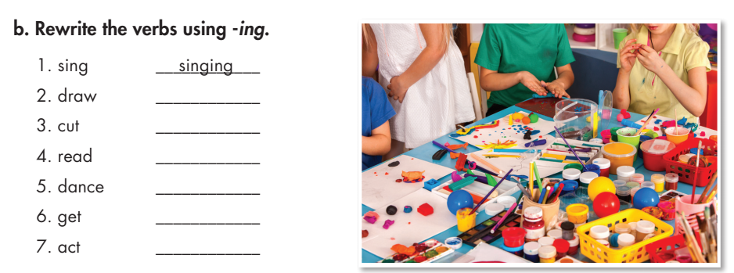
Lesson 2
drawing
cutting
reading
dancing
getting
acting

Slide 19
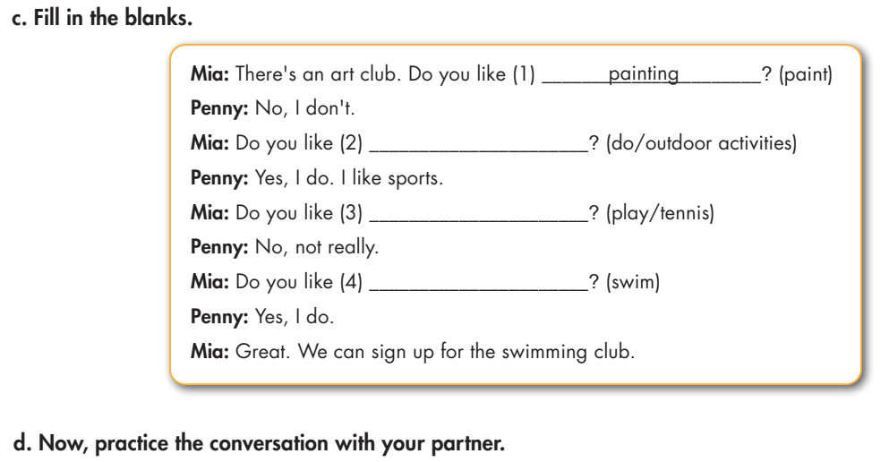
Lesson 2
doing outdoor activities
playing tennis
swimming

Slide 20
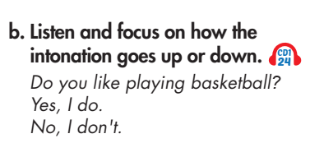
Lesson 2

Slide 21
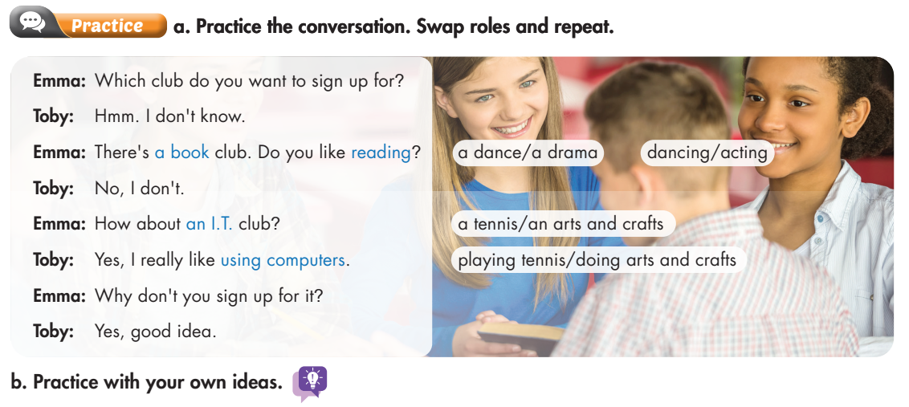
Lesson 2

Slide 22
Lesson 2

Slide 23
Homework
HOMEWORK:
- Learn by heart and Write down 2 lines/ each word &
3 times/ grammar.
- Write five sentences about your favorite indoor activities/outdoor activities.

